Slide 1
Electric Power Analytics Consortium
Department of Electrical and Computer Engineering
Cullen College of Engineering
University of Houston

Slide 2
Outline
UH Lab Overview
Potential Technique Issues
  Management of smart meter big data
  Transmission and distribution expansion planning
  Customer participation in grid operation, control and reliability
  Customer satisfaction
  Asset management
  Distributed energy resource integration
  Smart homes and smart buildings
  State estimation and cyber-security
  Impact of PHEVs on the existing power network
  Catastrophe modeling and planning

Slide 3
People
Wireless Amigo Lab
Department of Electrical and Computer Engineering
Faculty
  Zhu Han and Amin Khodaei
  Affiliated: Rong Zheng, CS, UoH; Wotao Yin, Rice; Lingyang Song, Beijing Univ.
Current Members
  Postdoc: S.M.Perlaza
  7 Ph.D. students, 3 M.S. students
Alumnus
  J. Meng (Ph.D. 2010), supported by NSF ECCS-1028782
  Z. Yuan (Ph.D. 2012), supported by NSF CNS-0953377
  Y. Huang (Ph.D. 2012), supported by Dean’s fellowship
  B. Shrestha, VANET, (M.S. 2008), T. Mathews, USRP2, (M.S. 2012)
  Former Postdoc: W. Saad, Y. Li

Slide 4
Faculty Expertise:
  Microgrid operation and control
  Generation and transmission expansion planning
  Large-scale demand response
  Renewable energy integration
  Design and operation of smart homes and buildings
  Optimal PMU placement in power systems
  Security-constrained resource allocation

Slide 5
Faculty Expertise:
  Cyber-security
  State estimation
  False data injection
  Alternative resource allocation
  Demand side management
  Compressive sensing
  Wireless networking
  Smart grid communication

Slide 6
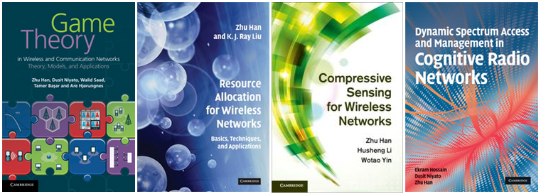
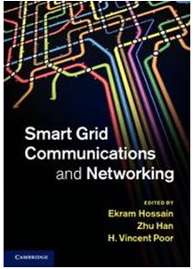
Education
Wireless Amigo Lab
Department of Electrical and Computer Engineering
Textbooks
About 100 journals and 200 conference papers published
7 best paper awards include 2 for smart grid
  IEEE Smartgridcom 2012
  IEEE WCNC 2012

Slide 7
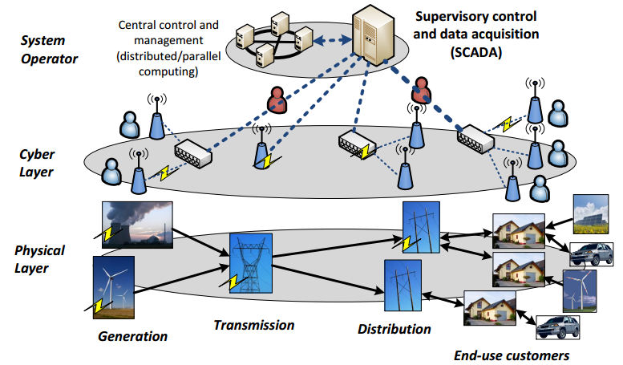
Problem and Challenge
Management of smart meter big data
Department of Electrical and Computer Engineering

Slide 8
Data Analysis
Management of smart meter big data
Department of Electrical and Computer Engineering
Exploiting optimization techniques for big data management and improve the solution of existing methods
Parallel/decentralized computing, application of computing clusters and cloud computing
Improving system controllability
Enhanced reliability

Slide 9
Problem and Challenge
Transmission and distribution expansion planning
Department of Electrical and Computer Engineering

Slide 10
Data Analysis
Transmission and distribution expansion planning
Department of Electrical and Computer Engineering
Determining the optimal size, time and location of the investments required to meet the forecasted load
Prevent overinvestment/underinvestment
Consider the role of distributed energy resources, responsive demands, and new types of loads such as plug-in vehicles
Objective: Develop efficient analytical models to optimally expand the transmission and distribution networks while taking the smart grid developments into account

Slide 11
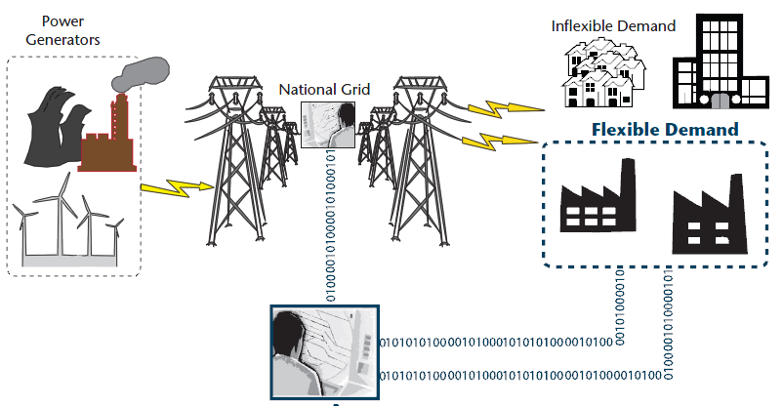
Problem and Challenge
Customer participation in grid operation, control and reliability
Department of Electrical and Computer Engineering

Slide 12
Data Analysis
Customer participation in grid operation, control and reliability
Department of Electrical and Computer Engineering
Electricity customers have the opportunity to understand and reduce their energy use.
If properly utilized, significant benefits will be achievable in power system operation, control and reliability.
  Peak shaving, load shaping, reduction in capital-intensive peak unit installation, reduction in transmission congestion, increased system reliability

Slide 13
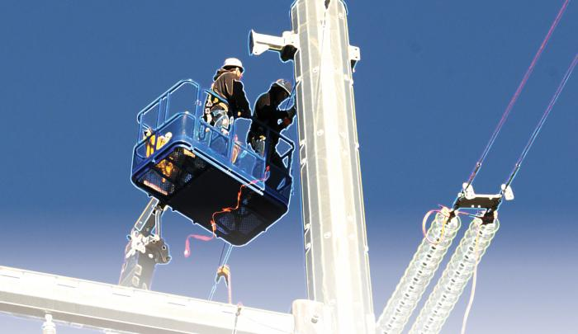

Problem and Challenge
Customer Satisfaction

Slide 14
Data Analysis
Customer Satisfaction
Department of Electrical and Computer Engineering
Customer satisfaction is in the heart of power system developments
Power system reliability is met to guarantee generation adequacy and supply the customers with no interruption in the electricity supply
The current digital age calls for enhanced power quality

Slide 15
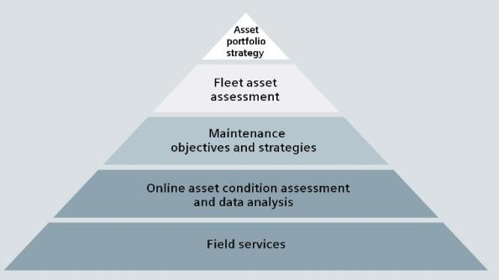
Problem and Challenge
Asset management
Department of Electrical and Computer Engineering

Slide 16
Data Analysis
Asset management
Department of Electrical and Computer Engineering
Timely maintenance of the aging power system infrastructure
Prevent unintended equipment outages and keep the system running with no interruption
Prevailing operation and economical constraints
  budget limitation
  labor restrictions
  customer interruption costs.

Slide 17
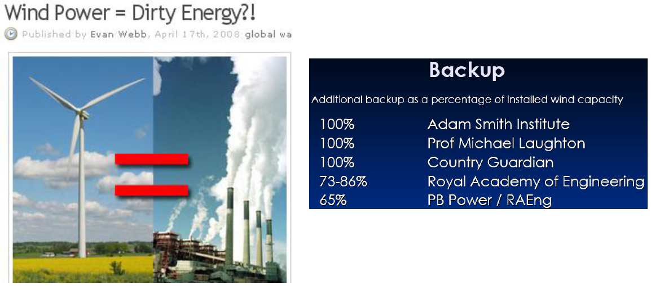
Problem and Challenge
Distributed renewable energy resource integration
Department of Electrical and Computer Engineering

Slide 18
Data Analysis
Distributed renewable energy resource integration
Department of Electrical and Computer Engineering
Installed in distributed places e.g. residential house roofs.
Renewable energy is hard to predict due to changing weather.
Such distributed and random nature is one key challenge to integrate those energy resources in smart grid.
  advanced prediction algorithms
  stochastic distributed optimization

Slide 19
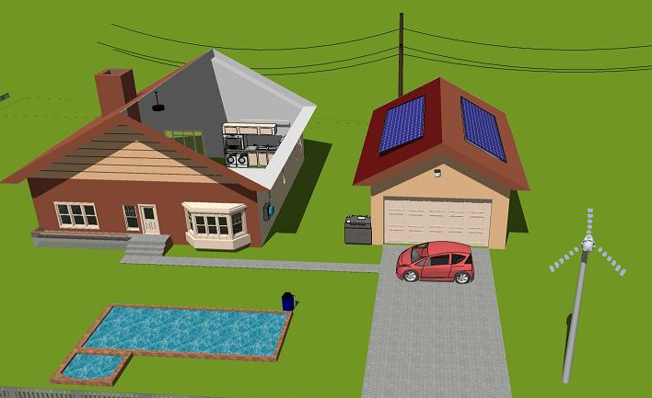
Problem and Challenge
Smart homes and smart buildings
Department of Electrical and Computer Engineering

Slide 20
Data Analysis
Smart homes and smart buildings
Department of Electrical and Computer Engineering
Residential consumers use more than one third of the total energy consumed in the United States
Smart homes and buildings:
  Enhanced conservation levels, lowered greenhouse gas emissions, lowered stress level on congested transmission lines.
The financial incentives offered to consumers, who would consider load scheduling strategies according to real-time electricity prices, is the most momentous driver for adjusting consumption habits.

Slide 21
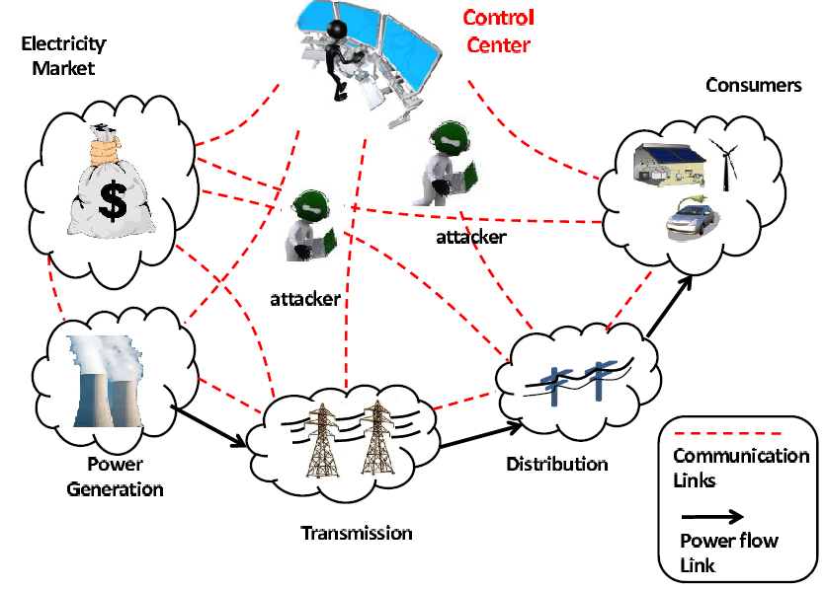
Problem and Challenge
State estimation and cyber-security
Department of Electrical and Computer Engineering

Slide 22
Data Analysis
State estimation and cyber-security
Department of Electrical and Computer Engineering
State estimation is a key function in building real-time model of electricity networks in Energy Management Systems (EMS).
False data may be due to unintended measurement abnormalities, topology errors, or injection by malicious attacks.
The potential mathematic tools include machine learning, quickest detection, independent component analysis, and even game theory to analyze the equilibrium between attackers and defenders.

Slide 23
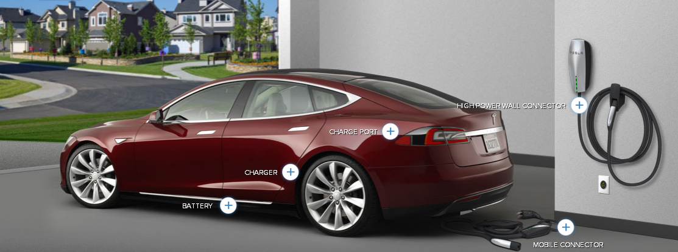
Problem and Challenge
Impact of PHEVs on the existing power network
Department of Electrical and Computer Engineering

Slide 24
Data Analysis
Impact of PHEVs on the existing power network
Department of Electrical and Computer Engineering
PHEVs will replace the traditional fuel powered vehicles in the foreseeable future
The PHEV charging will cause significant load in the power network
PHEVs contain a lot of energy which will only be used during the traffic hour. The energy can be used to reduce the power hour demand as well by serving as the battery reserves.
Optimal PHEV charging, so that the power system will not be overloaded

Slide 25
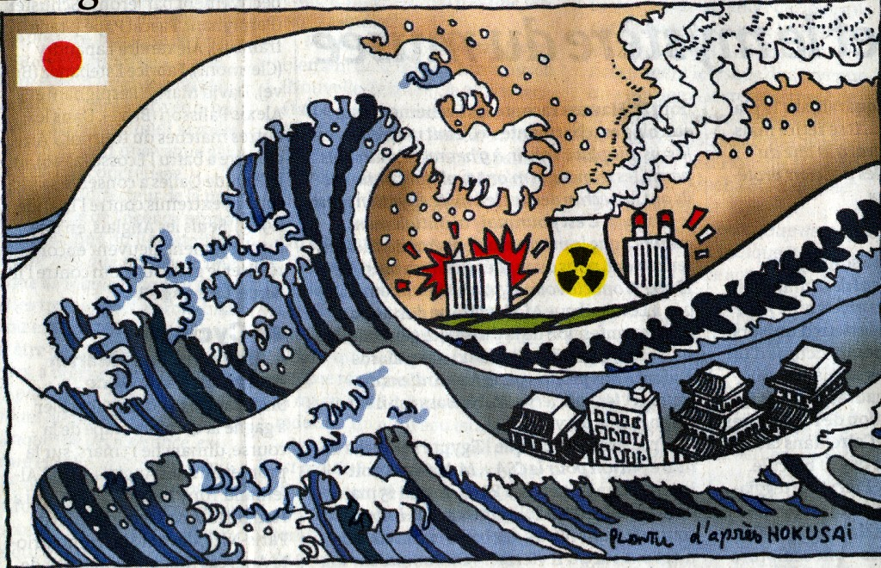
Problem and Challenge
Catastrophe modeling
Department of Electrical and Computer Engineering

Slide 26
Data Analysis
Catastrophe modeling
Department of Electrical and Computer Engineering
If we model the catastrophe and provide detailed plans for the workforces and resources before the catastrophe, the power system can be recovered much quicker.
This requires two types of analytic researches.
  First, how to model and predict the catastrophe based on the weather information. Some fast learning algorithms are needed from past experiences.
  Second, with different catastrophe level, how to design the corresponding plans. This can be modeled mathematically as Recourse, which optimizes different plans with different level of natural disasters, respectively

Slide 27


Other Ideas and Suggestions
Thank you
Department of Electrical and Computer Engineering

